Slide 1



Journey PPT
Tanishqa Aggarwal
18 Aug 2023 - 25 Aug 2023
Week 1

Slide 2


Day 1
Business Analysis
Business analysis is a discipline within the field of business and project management that focuses on identifying business needs, defining solutions, and facilitating communication between stakeholders to drive successful outcomes.
Requirement Analysis is a systematic approach to understanding, documenting, and defining the needs and expectations of stakeholders for a software system, product, or project.
Requirement Analysis

Slide 3
Day 1
Software Development Lifecycle
Software Development Life Cycle or SDLC is a structured framework that outlines the various stages and activities involved in developing software applications or systems. The SDLC provides a systematic approach to software development, ensuring that projects are well-organized, efficient, and produce high-quality software that meets user requirements.
Introduction to Agile Developemnt
Agile development is an approach to software development that emphasizes flexibility, collaboration, and iterative progress. It aims to deliver high-quality software in a more responsive and adaptive manner compared to traditional linear approaches like the Waterfall model.

Slide 4





Day 2
Kanban
Scrum Fundamentals
Planning and Estimation in Agile
Kanban is an agile framework used for visualizing work, optimizing workflow, and improving the efficiency of processes. Originating from lean manufacturing principles, Kanban has been widely adopted in software development and other knowledge work domains. It provides a flexible approach to managing tasks, promoting transparency, continuous improvement, and a focus on delivering value.
Scrum is a popular agile framework used for managing complex projects, primarily in software development but applicable to various industries.
Scrum Team:
Product Owner
Scrum Master
Development Team
Agile planning involves determining what work needs to be done, in what order, and how it will be accomplished. Instead of creating detailed plans for the entire project upfront, Agile teams plan in short cycles to adapt to changing requirements and feedback.
Estimation in Agile is about assessing the effort or relative size of tasks or work items.
Agile Lifecycle
Burnup and Burndown chart
The Agile lifecycle emphasizes continuous collaboration, flexibility, and responsiveness to changes throughout the development process. It is typically structured into a series of short iterations or sprints, each of which results in a potentially shippable product increment.
A burnup chart, also known as an "earned value chart," shows the accumulation of work completed over time.
A burndown chart visually represents the amount of work remaining in a project or iteration over time.

Slide 5
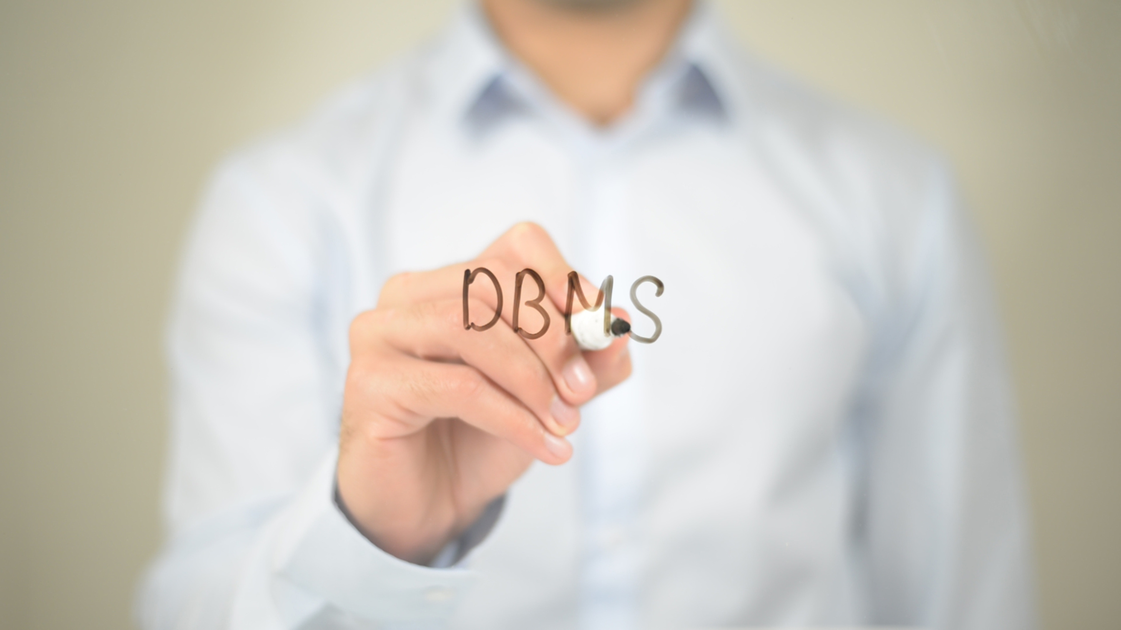
Day 3
A Database Management System (DBMS) is software that facilitates the management, creation, organization, retrieval, modification, and administration of databases. Databases are structured collections of data that are stored electronically, and a DBMS provides an interface for users and applications to interact with these databases.
Types of DBMS
RDBMS
NoSQL
NewSQL
This type uses tables to store data, where data is organized in rows and columns. Examples include MySQL, PostgreSQL, Oracle Database, and Microsoft SQL Server.
These databases use non-relational models to store and retrieve data. Types include document stores, key-value stores, column-family stores, and graph databases. Examples include MongoDB, Cassandra, Redis, and Neo4j.
A newer category that combines the benefits of traditional RDBMS with the scalability of NoSQL databases. Examples include Google Spanner and CockroachDB.

Slide 6

Day 3
CREATE
CREATE TABLE table_name ( column1 datatype, column2 datatype, ... );
PostgreSQL
PostgreSQL, often referred to simply as "Postgres," is an open-source relational database management system (RDBMS). It is known for its robustness, extensibility, and advanced features, making it a popular choice for a wide range of applications, from small projects to large enterprise systems.
INSERT
INSERT INTO table_name (column1, column2, ...) VALUES (value1, value2, ...);
QUERY
SELECT column1, column2, ... FROM table_name WHERE condition;
DELETE
DELETE FROM table_name WHERE condition;

Slide 7

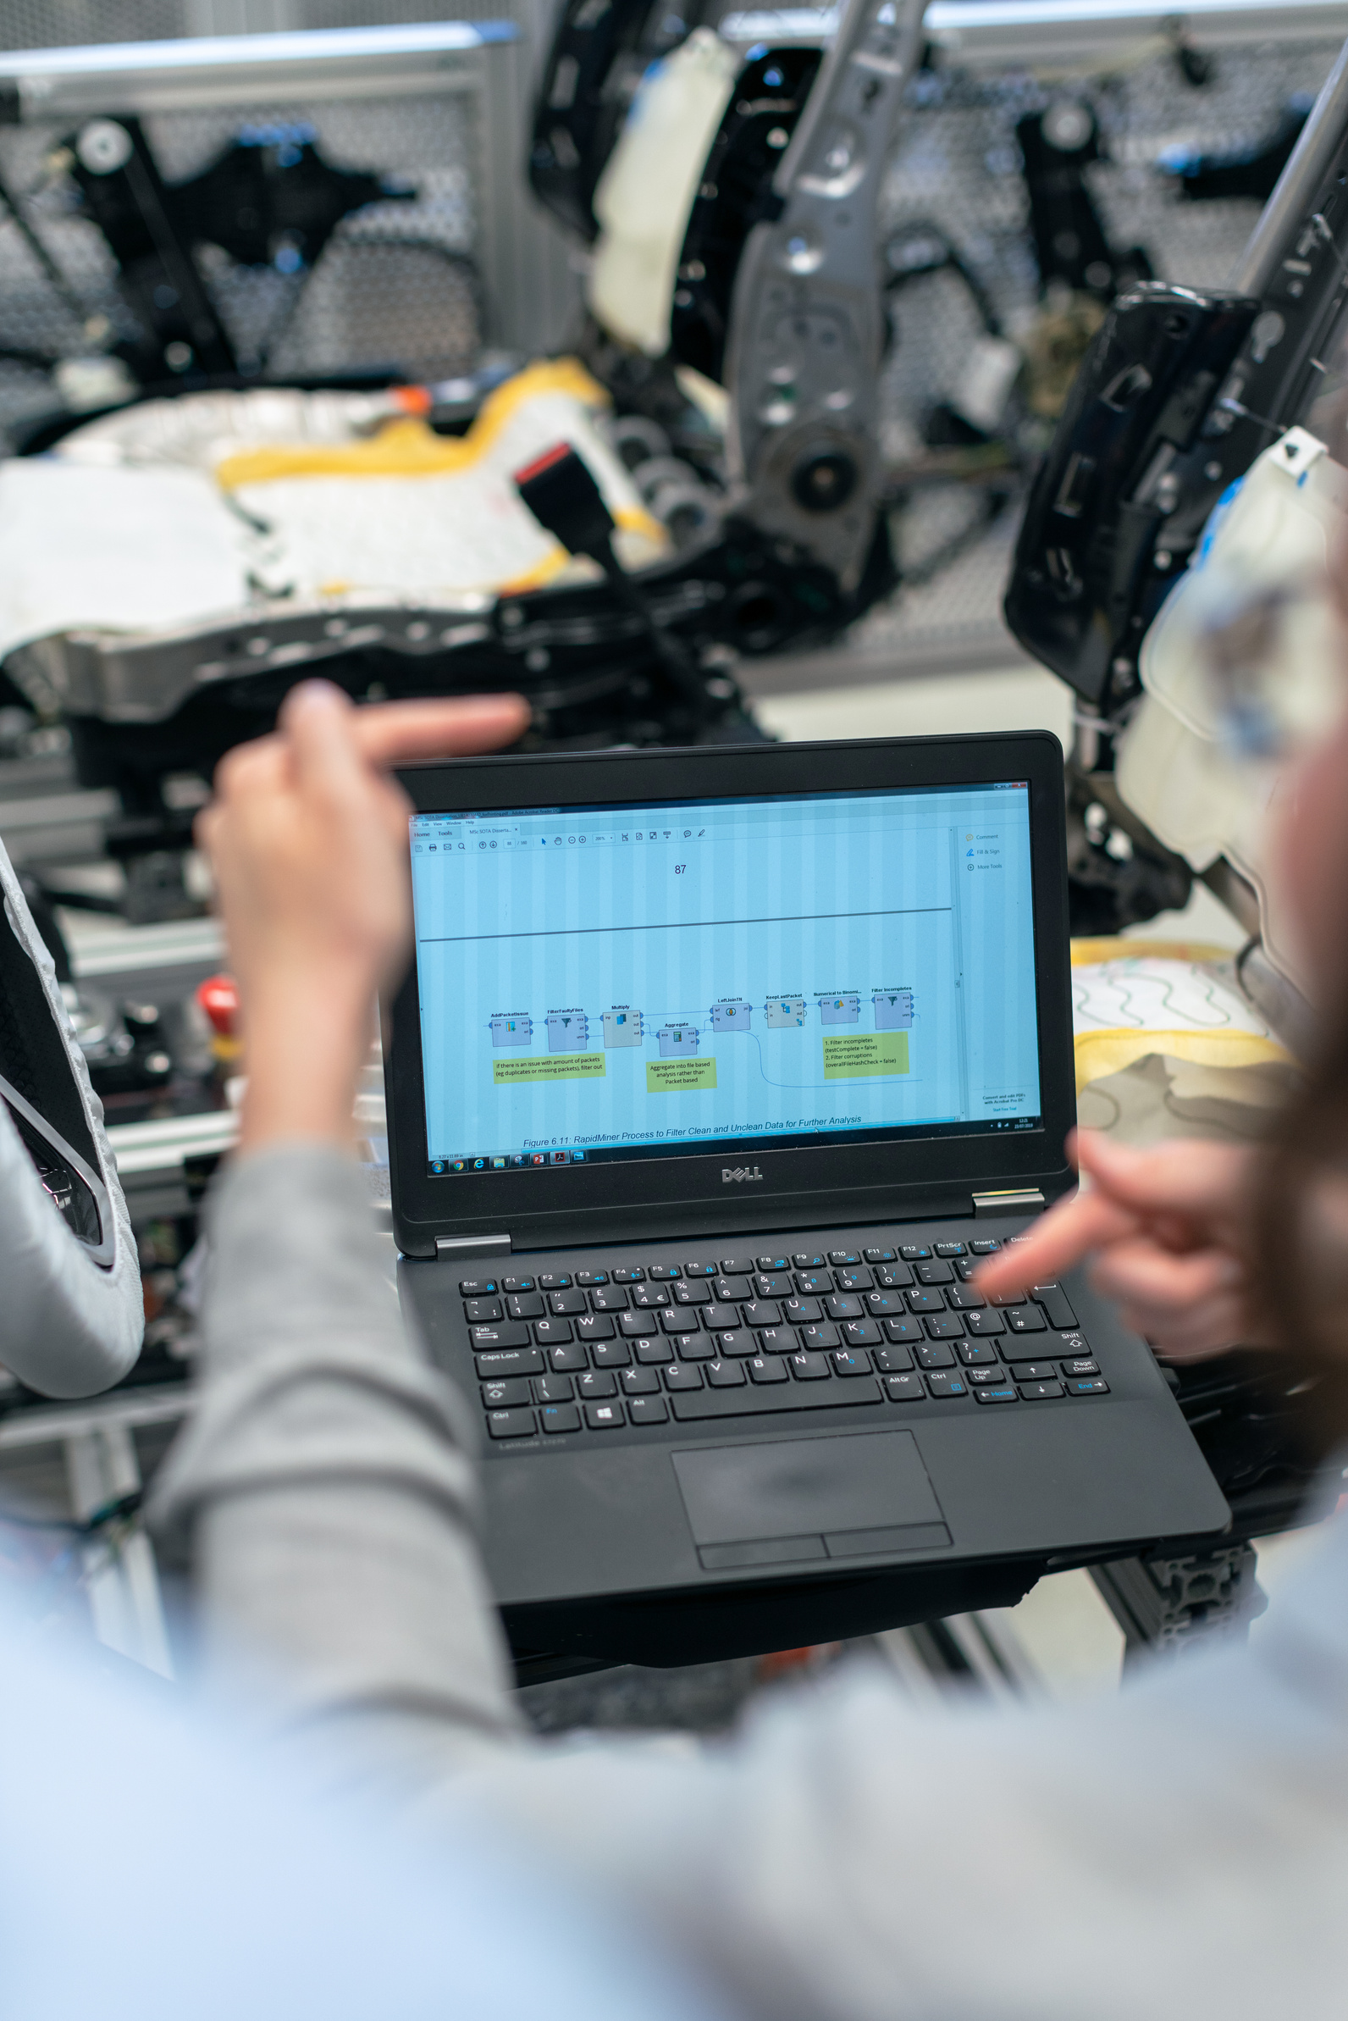
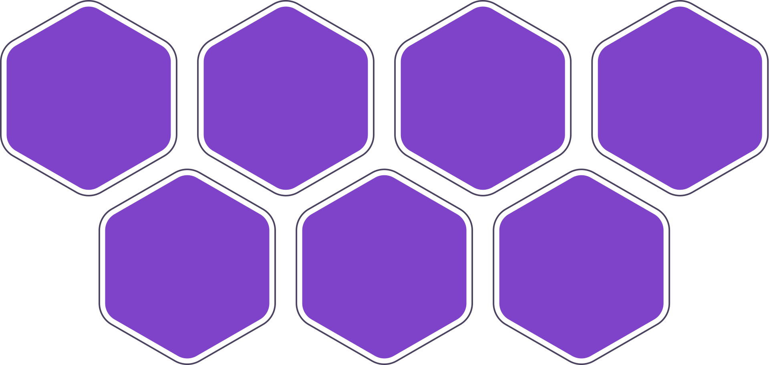
Day 4
Testing
Software testing is a critical process in the software development lifecycle that involves evaluating a software application to identify defects, ensure its quality, and validate that it meets specified requirements. The primary goal of software testing is to uncover errors, bugs, and issues in the software before it is released to users. Testing helps ensure that the software functions correctly, performs well, and provides a positive user experience.
STLC
STLC stands for Software Testing Life Cycle. It is a structured process that defines the various stages and activities involved in testing a software application.
Test
Strategy
Test
Plan
Test
Design
Test
Environment
Test
Execution
Defect
Reporting
Test
Closure

Slide 8

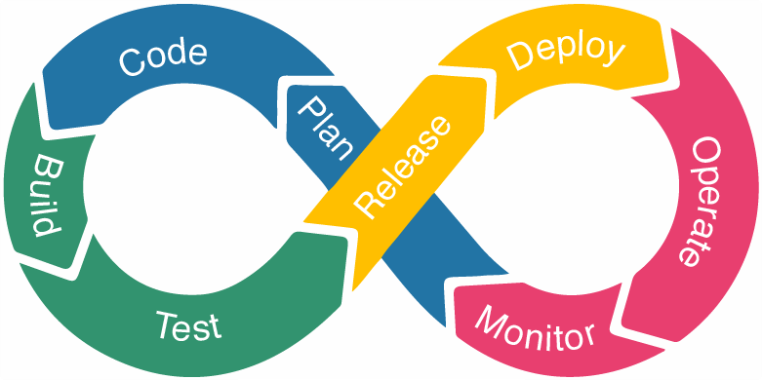
Day 5
DevOps
DevOps is a set of practices, principles, and cultural philosophies that aim to improve and streamline the collaboration between software development (Dev) and IT operations (Ops) teams. The goal of DevOps is to shorten the software development life cycle, increase the frequency of software releases, and improve the quality, reliability, and efficiency of software delivery.

Slide 9
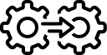
Day 5
Continous Integration
Continous Delivery
Developers frequently integrate their code changes into a shared repository, where automated tests are run to identify defects early. CI ensures that code changes are tested and validated in a timely manner.
CD extends CI by automatically deploying code changes to a staging or production environment after passing automated tests. This allows for rapid and reliable software releases.

Slide 10
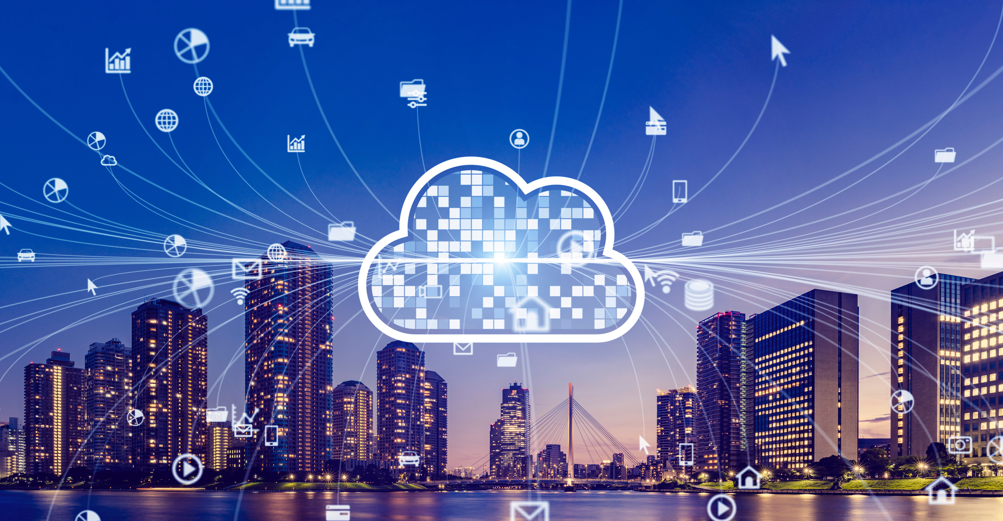
Day 6
Cloud Computing
Cloud computing is a technology paradigm that involves delivering various computing services—such as storage, processing power, databases, networking, software, and more—over the internet ("the cloud"). Rather than owning and maintaining physical hardware and infrastructure, users can access and use these resources on-demand from cloud service providers.
Service Models
Infrastructure as a Service (IaaS)
Platform as a Service (PaaS)
Software as a Service (SaaS)

Slide 11

Thank You

